Slide 1



FINANCE FALCONS
JANUARY 2025
ACCOUNTS
Marketing Plan | January 2025

Slide 2

Project Overview:
The accounts module of the full-stack banking project aims to provide comprehensive functionality related to managing customer accounts. This module involves displaying active accounts based on the customer's username, updating customer details, closing account services, and creating new accounts. It integrates both front-end and back-end components to facilitate seamless interaction between users and the banking system.
2. Objectives:
User Authentication
Account Display
Update Customer Details
Close Account Services
Create New Account
Modular Flow

Slide 3
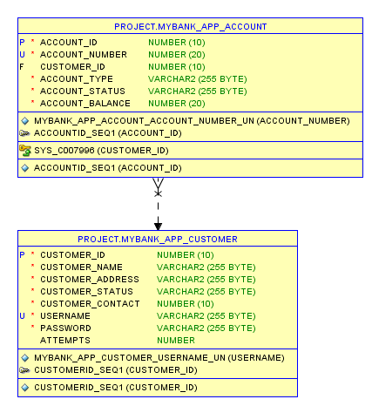
Database Design
11

Slide 4
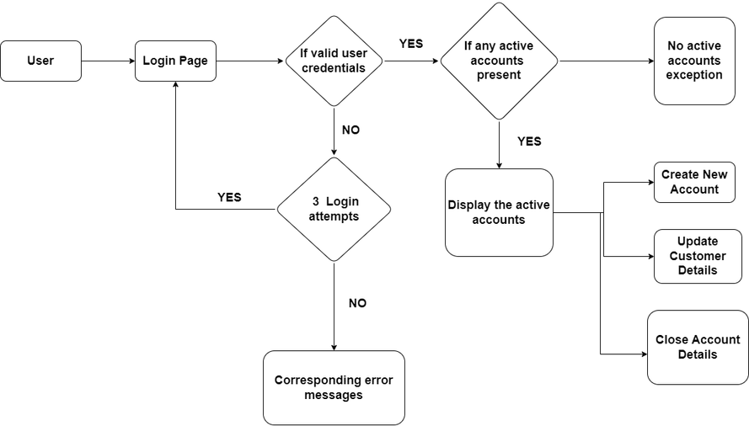
Modular
Diagram

Slide 5
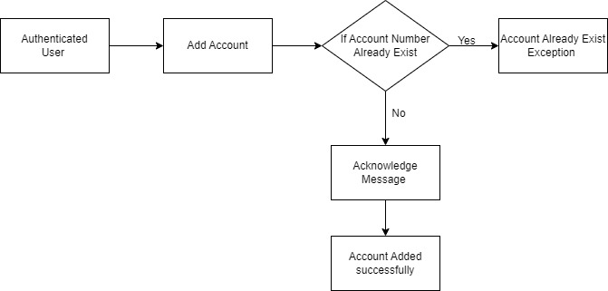
Modular Diagram - POST Mapping (Creating New Account)

Slide 6
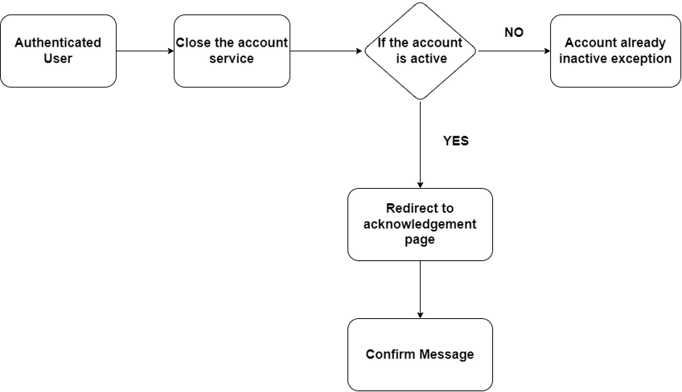
Modular Diagram - PUT Mapping (Close Account Services)

Slide 7
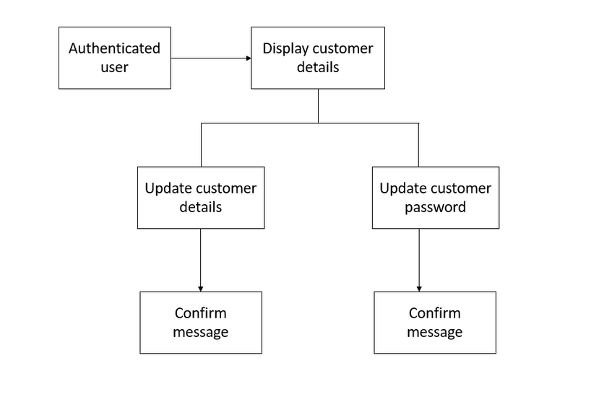
Modular Diagram - PUT Mapping (Updating Customer Details)

Slide 8
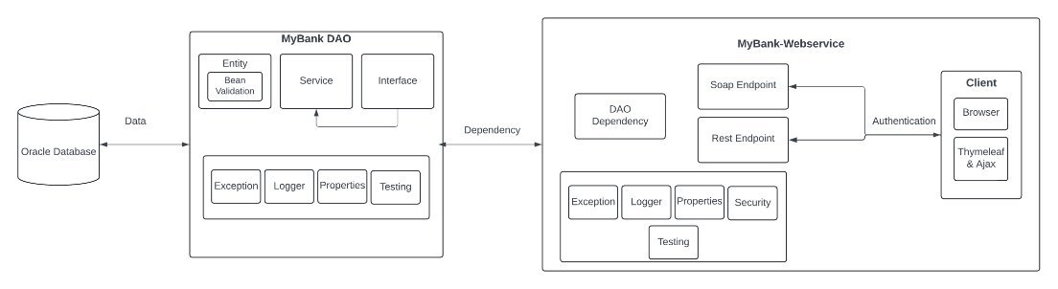
Project Structure

Slide 9

Marketing Plan | January 2025
15
Thank you!
Let us know if you have questions or
need clarifications.
JANUARY 2025

